Slide 1
First Day Information

Slide 2
Where am I?
PSY 745
Mondays 12:20-2:20
Labs:
W 12:20-2:20
W 2:35-4:35

Slide 3
Who is this person?
Dr. B
Dr. Buchanan (only if you spell it right)
NOT
Ms or Mrs anything

Slide 4

Who is this person?
http://aggieerin.com or follow the DOOM lab on Twitter @aggieerin

Slide 5

Who is this person?

Slide 6

Who is this person?

Slide 7
Office
Hill Hall 214D
Hill Hall 460

Slide 8
Contact
Office hours:
MW 11-12PM
Email
erinbuchanan@missouristate.edu

Slide 9
Help Hours
Jessica Willis
Katy Miller
Help Desk Blackboard!

Slide 10
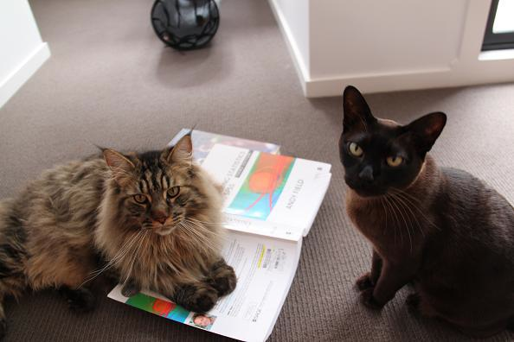
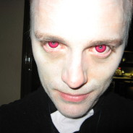
Book

Slide 11

Blackboard
ALL THE THINGS!

Slide 12
Assignments
Practice the stuff we learn in class (25%)
You can work together
You will turn in R syntax
You will learn how to write (oh no!)

Slide 13
Exams
Three exams (60%)
Each exam has a take home and in class portion
Stats is cumulative, but the exams are not purposely cumulative.
You must work on these individually.

Slide 14
Labs
Labs! (15%)
We will practice things in class, which you will complete and get credit for.
Note about the labs: do them in lab or get a zero.

Slide 15
Late Policy
Dude, this is graduate school.
Be serious.
Ok, fine 25% off per day.

Slide 16

Make Up Policy

Slide 17

Classroom Policy

Slide 18
Schedule
Look at that schedule!
Isn’t it cute?!
We’ll see if it works!

Slide 19
Now let’s do stuff
Chapter 1

